Slide 1


Social Interaction Assistant An Assistive and Rehabilitative Technology to Enrich the Social Interactions for Individuals who are Blind and Visually Impaired
CUbiC
CENTER FOR COGNITIVE UBIQUITOUS COMPUTING
Sreekar Krishna
Committee:
Dr. Sethuraman (Panch) Panchanathan, Chair
Dr. Baoxin Li Dr. Michelle (Lani) Shiota
Dr. Gang Qian Dr. John Black
ARIZONA STATE UNIVERSITY

Slide 2
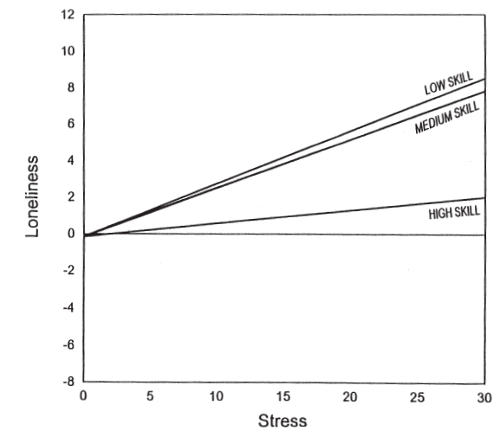
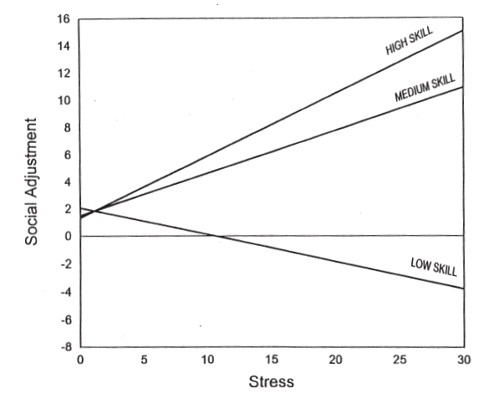
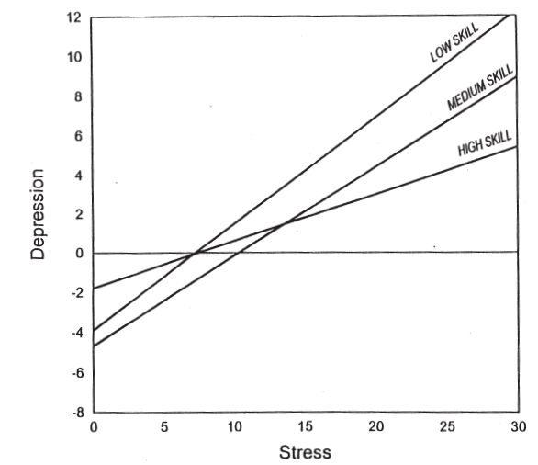
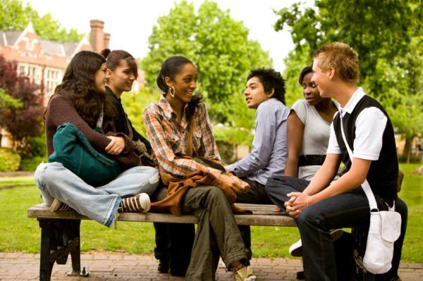

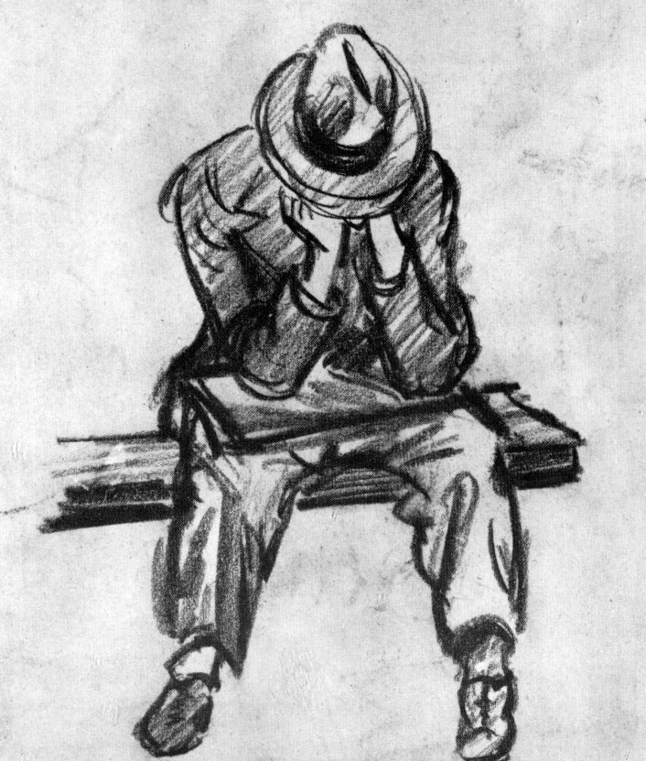

Importance of Social Skills
Loneliness
Social Adjustment
Depression
Social Skills
Verbal
Nonverbal
Skill in
Verbal expression
Verbal fluency
Initiating conversation
Skill in communicating
Affect
Attitude
Status
Emotion
The Work and Social Adjustment Scale
UCLA Loneliness Scale
Beck Depression Inventory
CENTER FOR COGNITIVE UBIQUITOUS COMPUTING

Slide 3
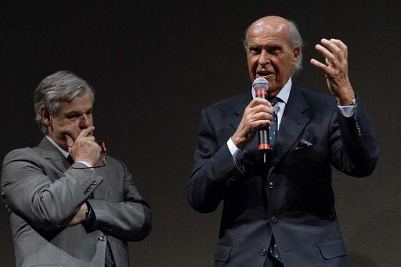
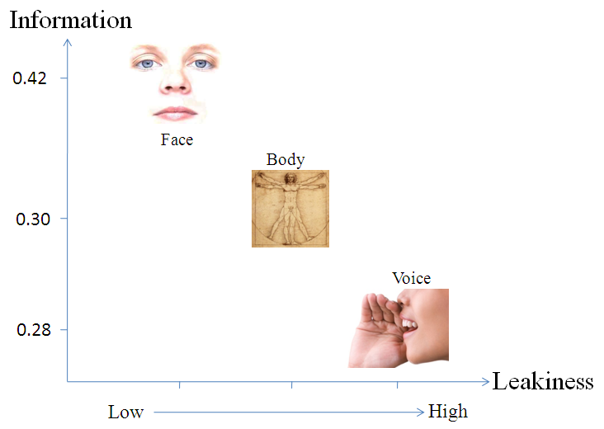
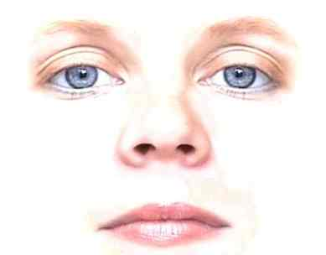
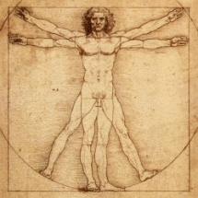
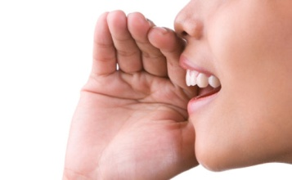
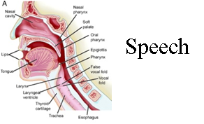
Non Verbal Cues
Enactor - Encoding
Recipient - Decoding
Face
Non Verbal
Verbal
Visual (46%)
Non-verbal (65%)
Body
Voice
Audio (54 %)
Verbal
65%
Verbal (35%)
Face and Body
Nonverbal
Prosody
Speech
CENTER FOR COGNITIVE UBIQUITOUS COMPUTING

Slide 4
Visual Non-Verbal Cues in Communication
Sensory Deficit
Visual Impairment
Blindness
Low Vision
Communication Environment
Physical Attributes of the Partner
Behavior of the partner
Familiarity of the environment
Colors in the environment
Other people in the environment
Architectural Designs
Objects in the environment
Sounds
Lighting
Temperature
The human facial attractiveness
body shape
height of a person
self image
body color
body smell
body hair
clothing
personality
body decoration or artifacts
Body
Posture
Face
Expressions
Gesture
Gestures
Eyes

Slide 5
Case Studies of People who are Blind
Sara
Jindal-Snape
Our own focus group

Slide 6
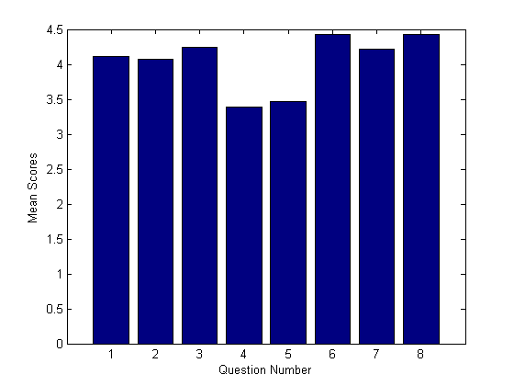
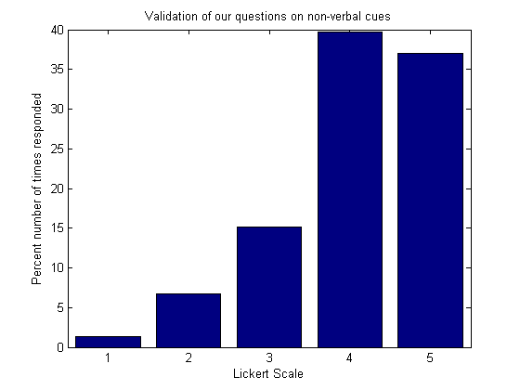
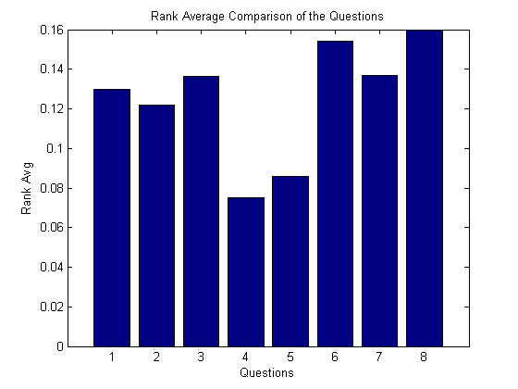
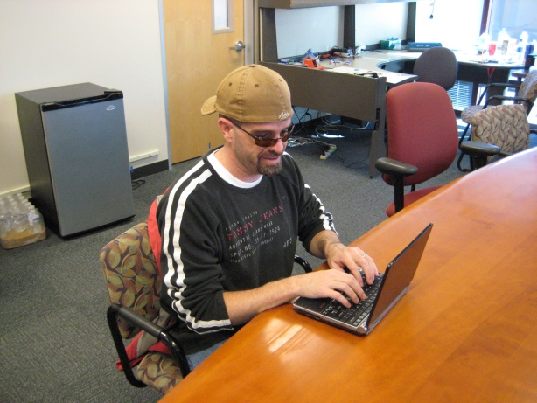
Self-Report Importance of Non-Verbal Cues
Question Number | Need
1 | Knowing how many people are standing in front you, and where each person is standing.
2 | Knowing where a person is directing his/her attention.
3 | Knowing the identities of the people standing in front of you.
4 | Knowing something about the appearance of the people standing in front of you.
5 | Knowing whether the physical appearance of a person who you know has changed since the last time you encountered him/her.
6 | Knowing the facial expressions of the person standing in front of you.
7 | Knowing the hand gestures and body motions of the person standing in front of you.
8 | Knowing whether your personal mannerisms do not ﬁt the behavioral norms and expectations of the sighted people with whom you will be interacting.
Need | Mean Score | Average Rank Score
Feedback on personal mannerism | 4.5 | 0.159
Understand Facial expression of others | 4.4 | 0.154
Identify people | 4.3 | 0.136
Understand Body gestures | 4.2 | 0.137
Number of people in a group & their locations | 4.1 | 0.129
Understand other’s attention | 4.0 | 0.121
Other’s physical appearance change from before | 3.5 | 0.08
Other’s physical appearance | 3.4 | 0.07
Need | Mean Score | Average Rank Score
Feedback on personal mannerism | 4.5 | 0.159
Understand Facial expression of others | 4.4 | 0.154
Identify people | 4.3 | 0.136
Understand Body gestures | 4.2 | 0.137
Number of people in a group & their locations | 4.1 | 0.129
Understand other’s attention | 4.0 | 0.121
Other’s physical appearance change from before | 3.5 | 0.08
Other’s physical appearance | 3.4 | 0.07
Focus Group on 8 Social needs
27 participants - 16 blind, 9 low vision and 2 sighted specialists.

Slide 7
Contributions from this Dissertation
Now to Dissertation
Stereotypic mannerism
Facial mannerisms
Body mannerisms
Identity
Proxemics
Gaze based attention
Change in physical attributes
Physical attributes
8
8
7
6
6
7
Focus
5
3
Importance
4
1
3
2
2
5
1
4
Feasibility
High

Slide 8
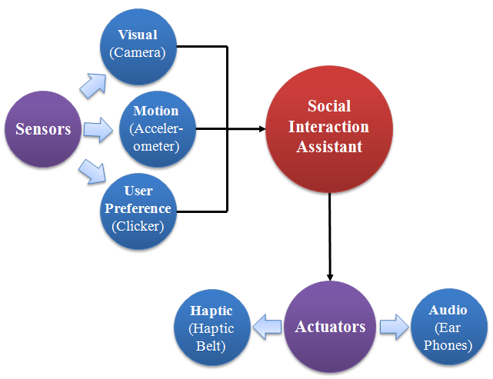
Design Considerations for Social Interaction Aid
Allow seamless and discrete embodiment of sensors
Determine both self and other’s social mannerism
Allow for long term use
Discriminate social stereotypic mannerisms from other functional movements
Be portable and wearable
Does not obstruct user’s abilities

Slide 9
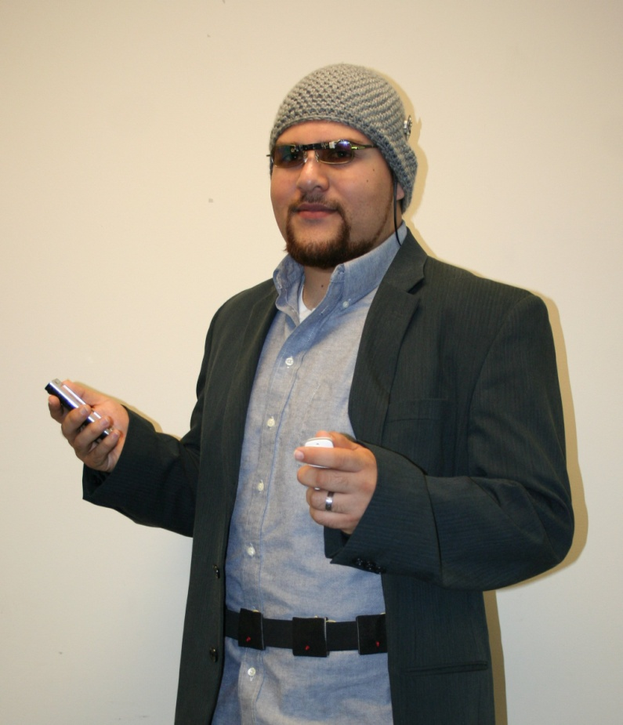
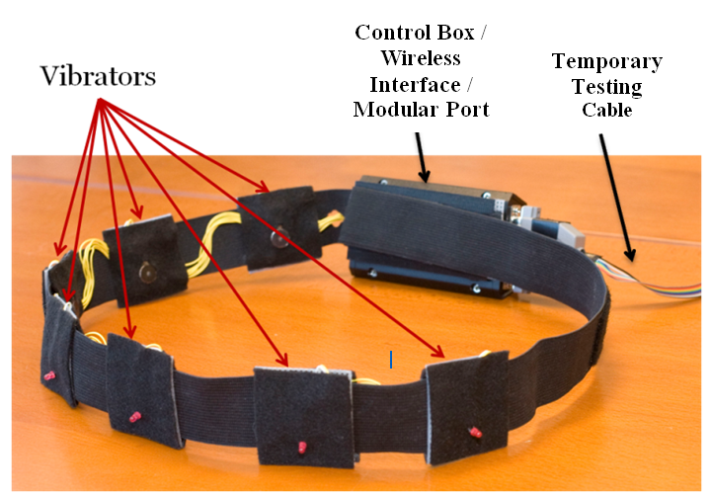
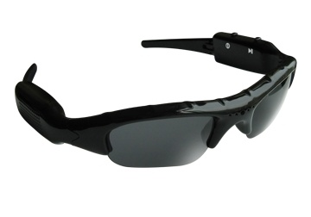
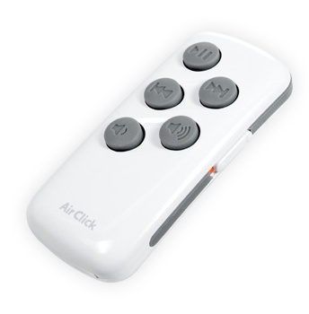
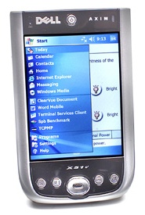
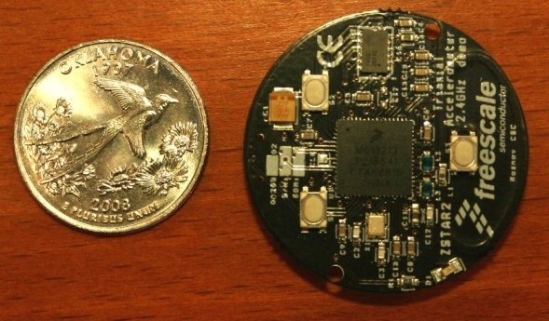
Social Interaction Assistant
Seamless and Discrete
Self and Other sensing
Long term us
Portable and wearable
No Obstructions
Miniature Motion Sensors
User Interface
Wearable Camera
PDA
Haptic Belt

Slide 10
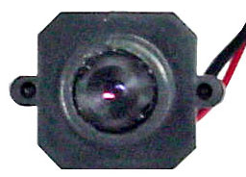
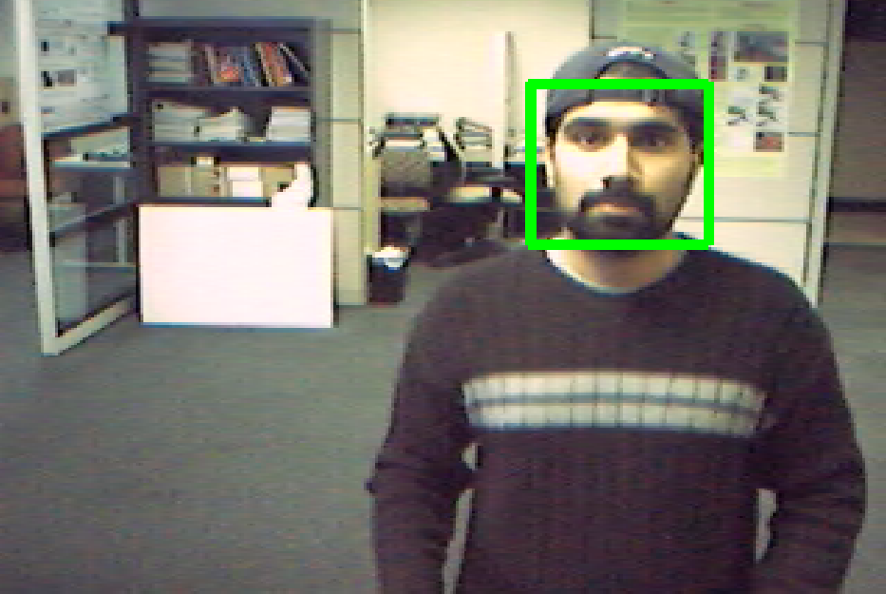
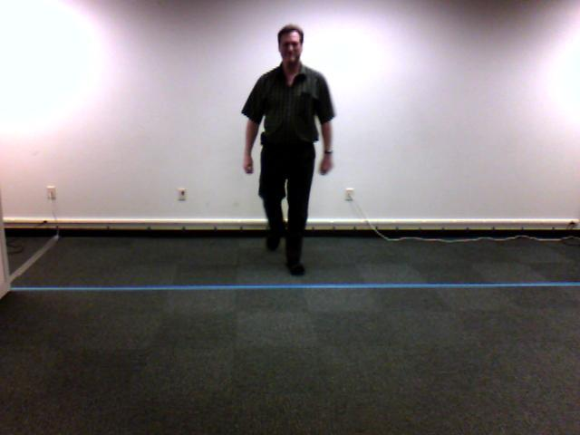
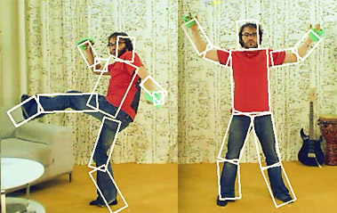
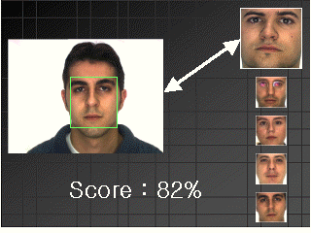
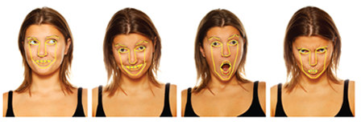
Sensing Technologies
Suite of Algorithms
Person Detection
Person Recognition
Facial Expression
Body Mannerisms
Face Detection
Camera

Slide 11
Proxemics

Slide 12
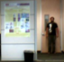
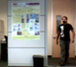
Tracking people using Structured Mode Searching Particle Fileter (SMSPF)
Step 1
Step 2
Motivation: Weak Temporal Redundancy
Motivation:ComplexObject Structure & Abrupt Motion
Approach: Deterministic Search over a small probable search space (Histogram of Gradients with Chamfer Match)
Approach: Stochastic Search over
a large search space (Color Histogram Comparison)
Result: Approximate Estimate
Initial Estimate
Corrected Estimate
Example Search Windows
Result: Accurate Estimate

Slide 13
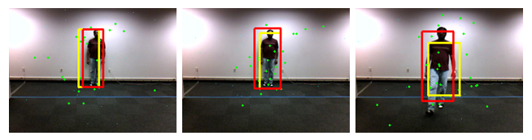
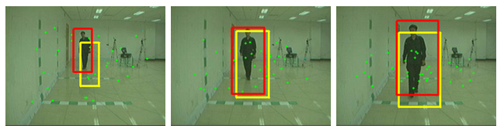
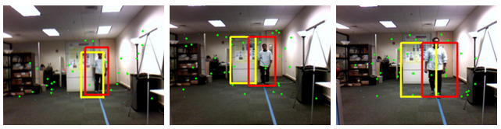
Results – Datasets and Evaluation Metrics
Area Overlap (AO):
Distance b.w Centroids (DC):
Tracking Evaluation Measure (Harmonic Mean of AO & DC )
Evaluation Metrics
DataSet 1 (Collected at CUbiC) : Plain Background; Static Camera; 320x240 resolution
DataSet 2 (CASIA Gait Dataset B with subject approaching the camera) : Slightly cluttered Background; Static Camera; 320x240 resolution
DataSet 3 (Collected at CUbiC) : Cluttered Background; Mobile Camera; 320x240 resolution

Slide 14
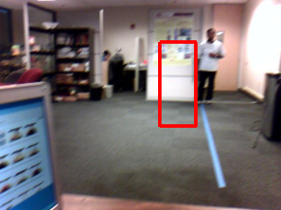
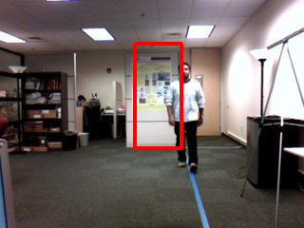
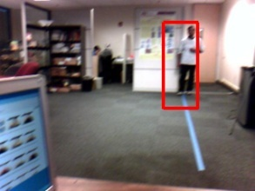
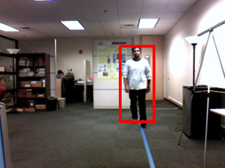
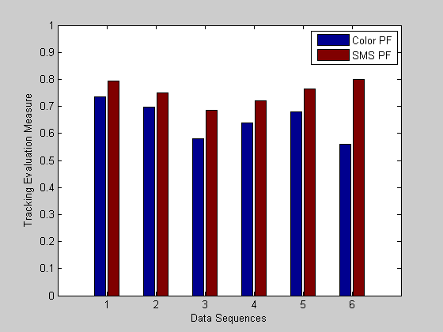
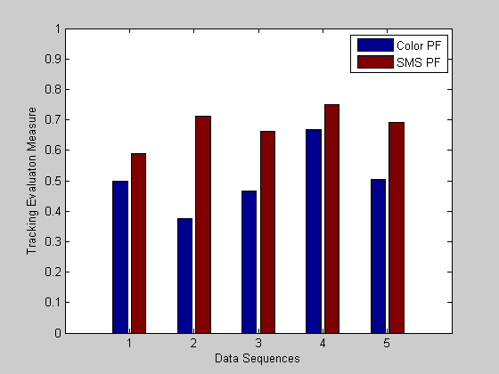
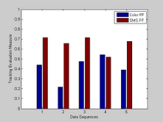
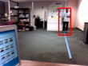
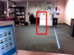
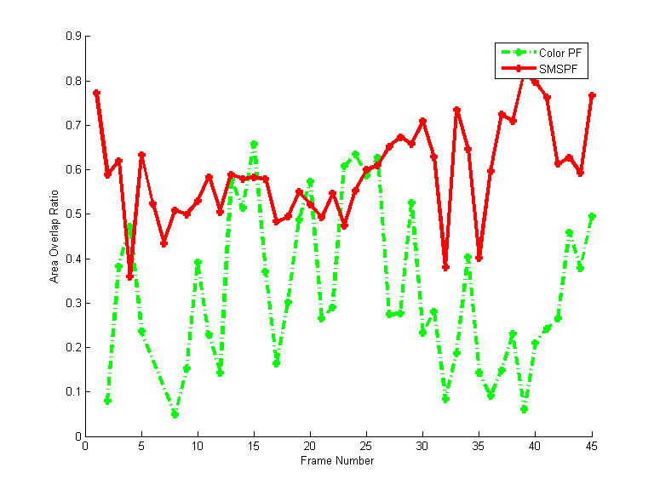
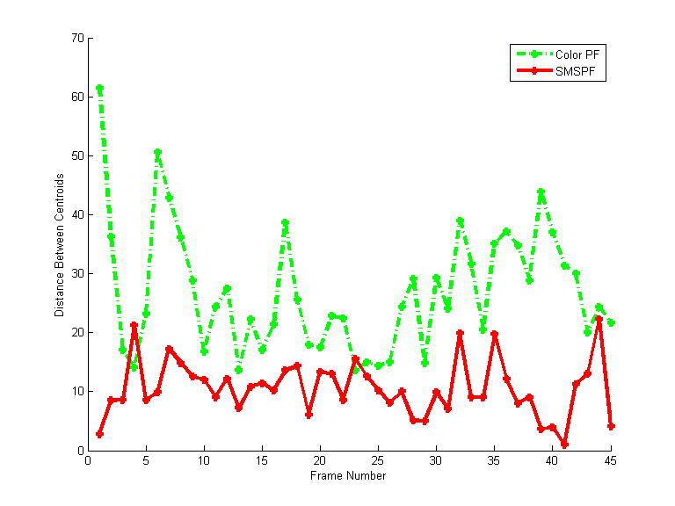
Results – Example Dataset
#2
#40
#2
#40
Color PF
SMSPF
Clear improvement in tracking results when compared with Numiaro’s Color based particle filtering
Area Overlap Ratio
Distance between Centroids

